Slide 1
Numerical problem on decision tree

Slide 2
ID3 Algorithm
1. Invented by J. Ross Quinlan
2. Employs a top-down greedy search through the space of possible decision trees.
3. Greedy because there is no backtracking. It picks the highest values first.
4. Select the attribute that is most useful for classifying examples (the attribute that has the highest Information Gain).

Slide 3
Numerical problem on decision tree using GINI INDEX

Slide 4


Steps
Find the Gini index for the entire dataset
Find the Gini index for each attribute
Formula for Gini index:

Slide 5
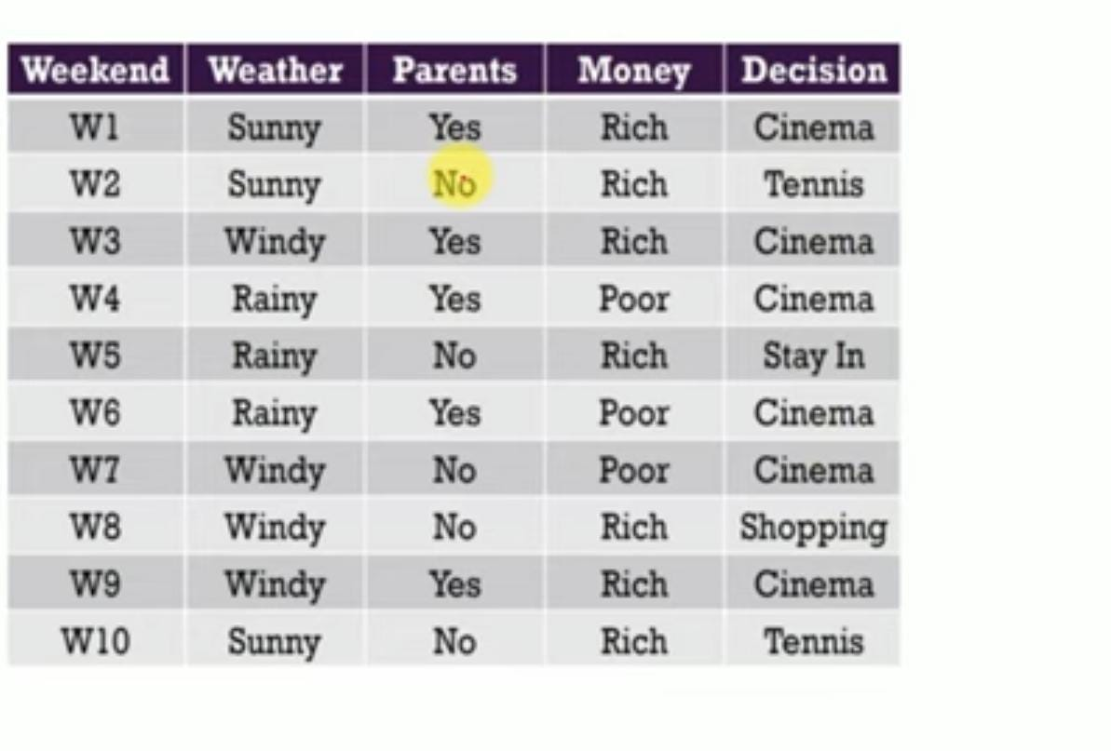

Slide 6
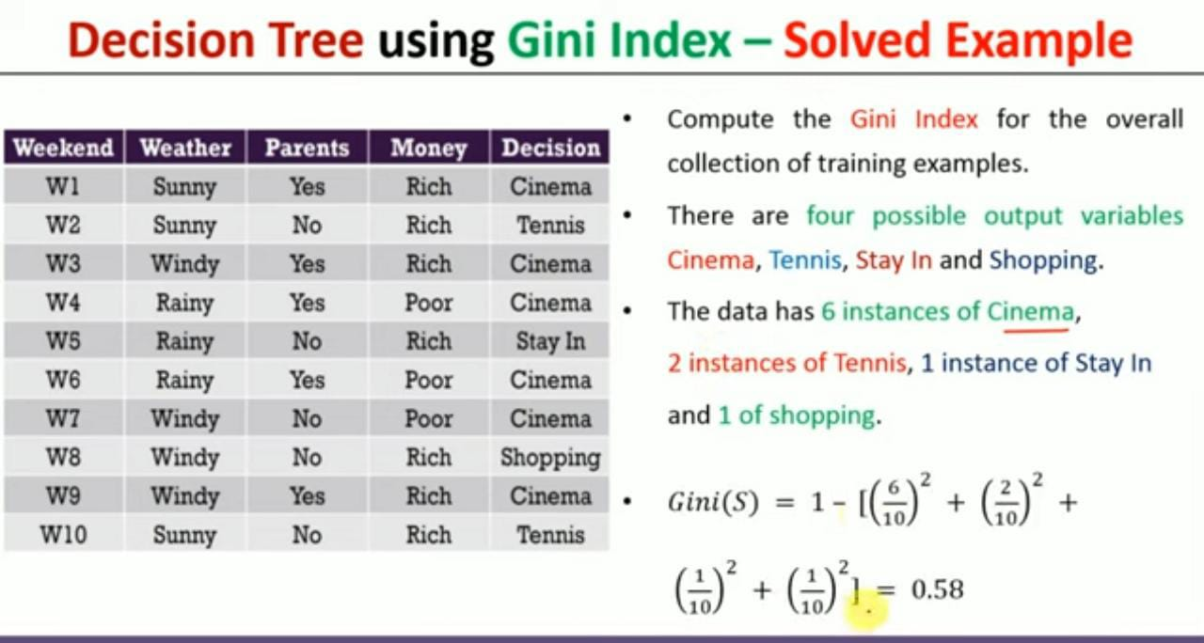

Slide 7
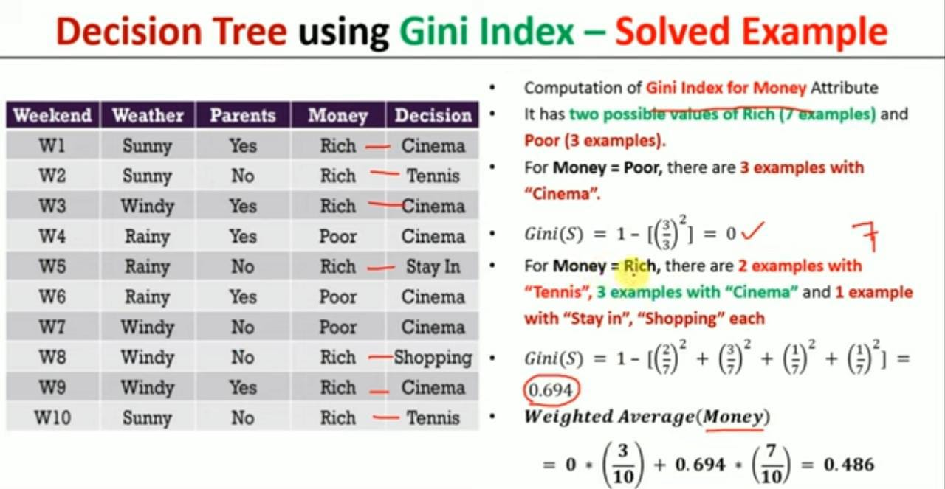

Slide 8
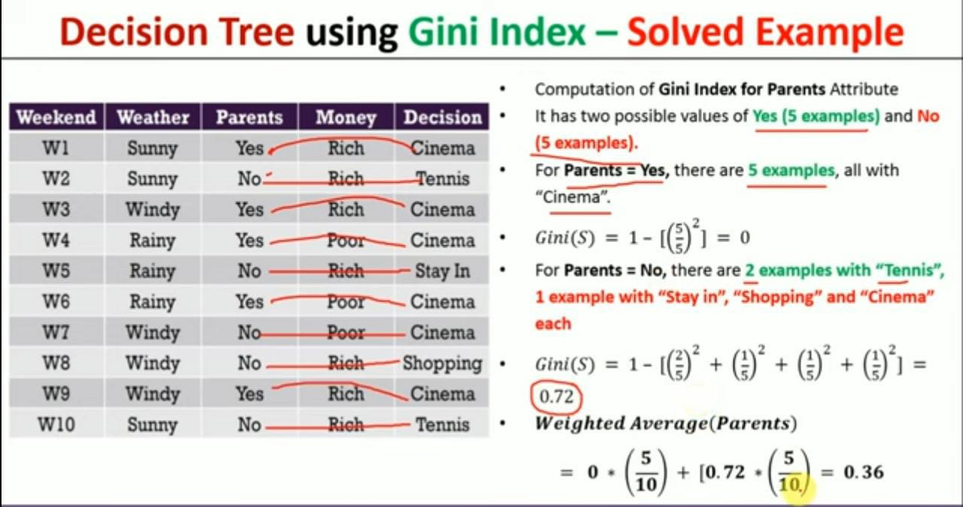

Slide 9
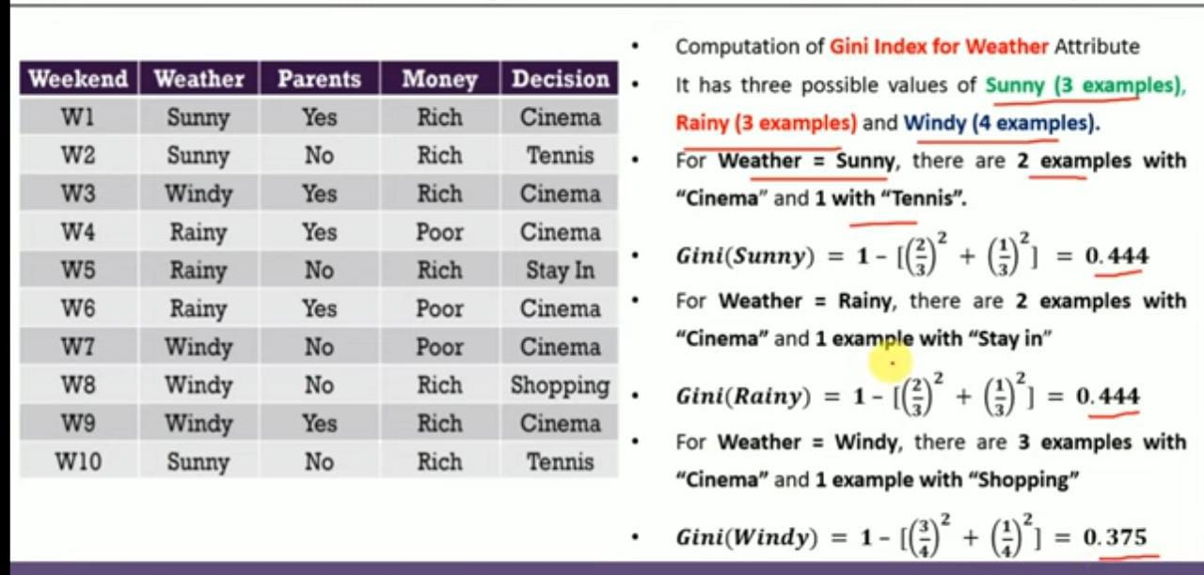

Slide 10
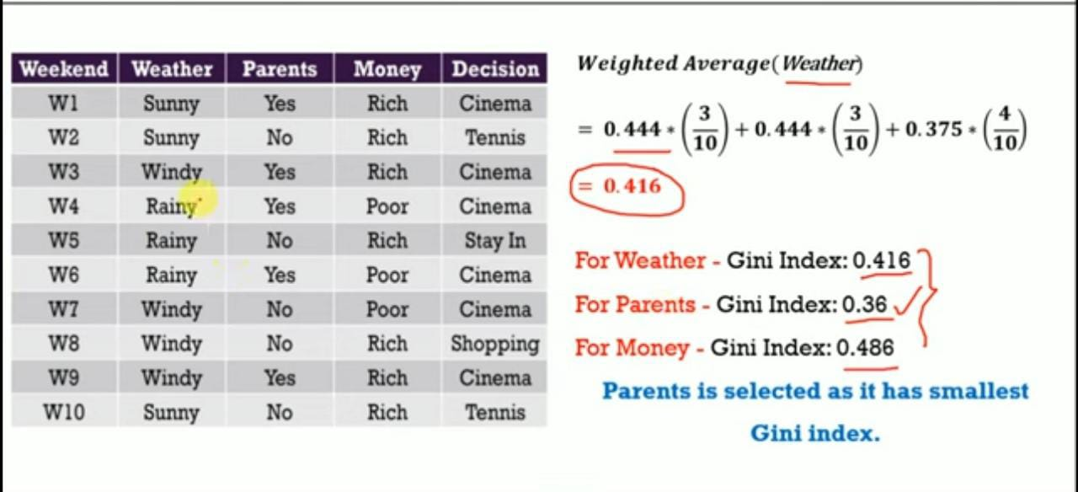

Slide 11
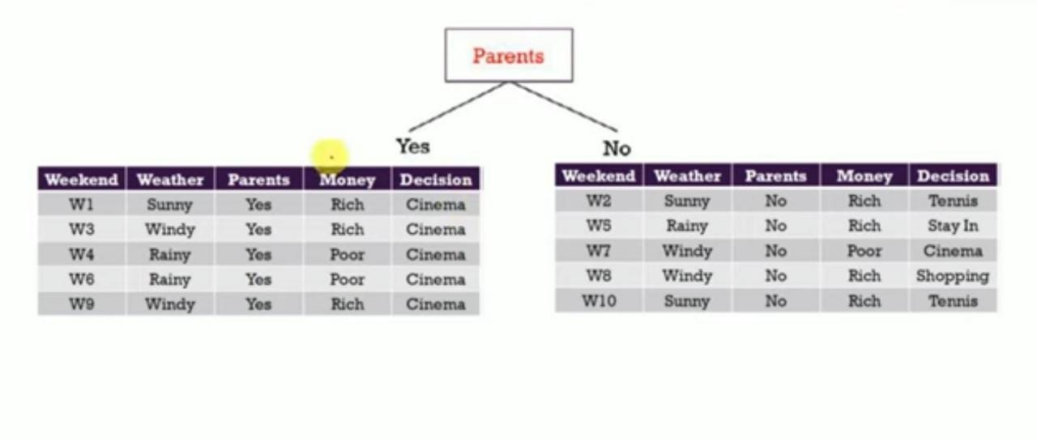

Slide 12
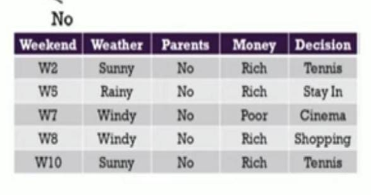
Parents
Yes
No
Cinema

Slide 13
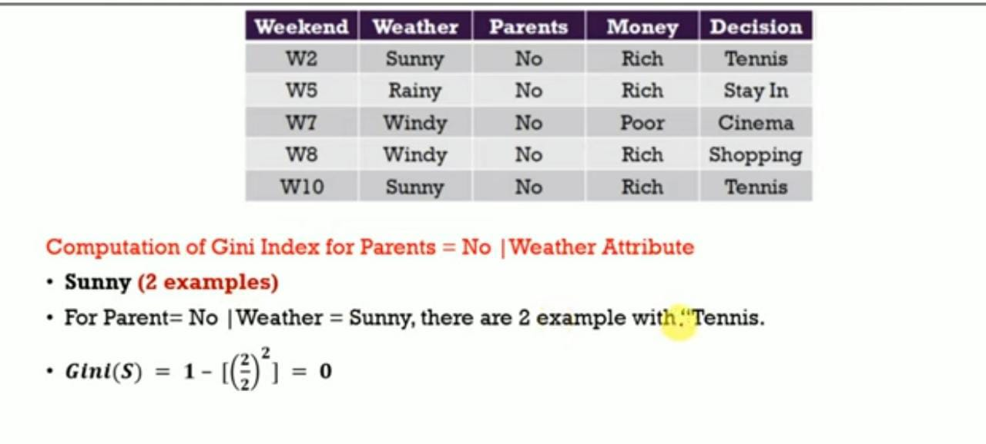

Slide 14
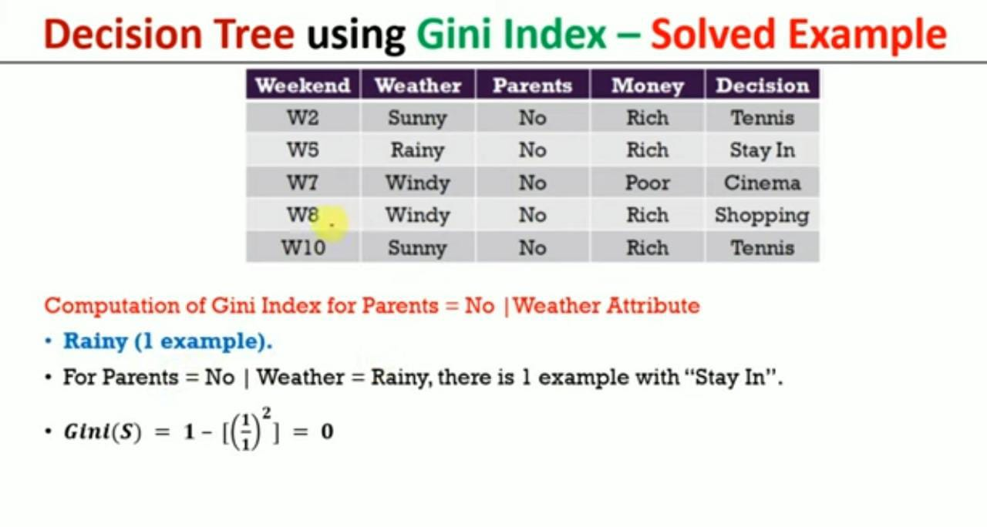

Slide 15
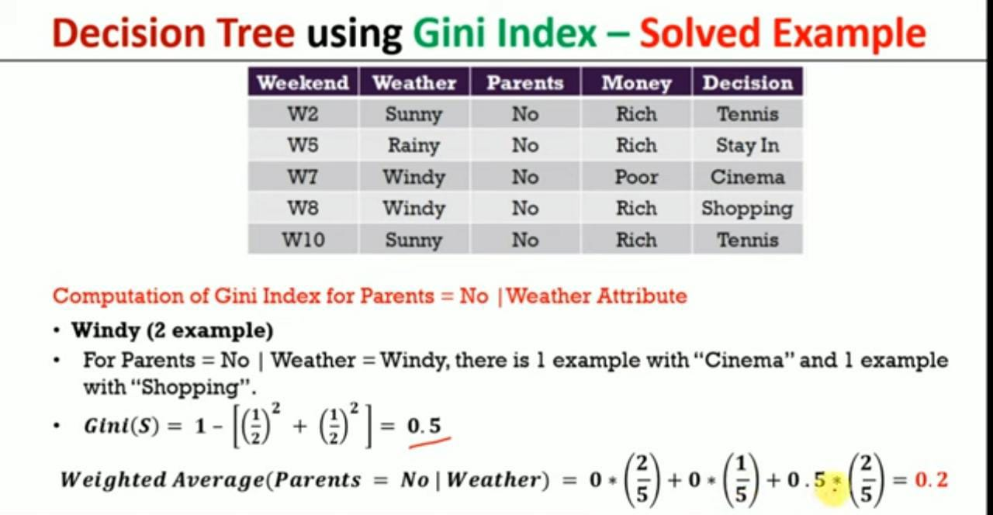

Slide 16
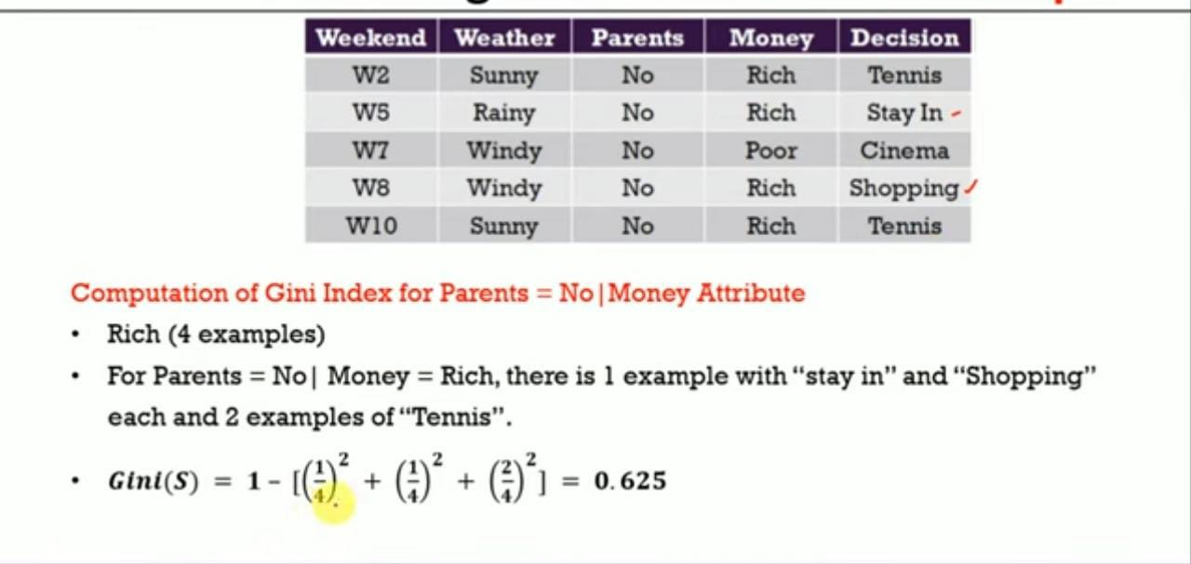

Slide 17
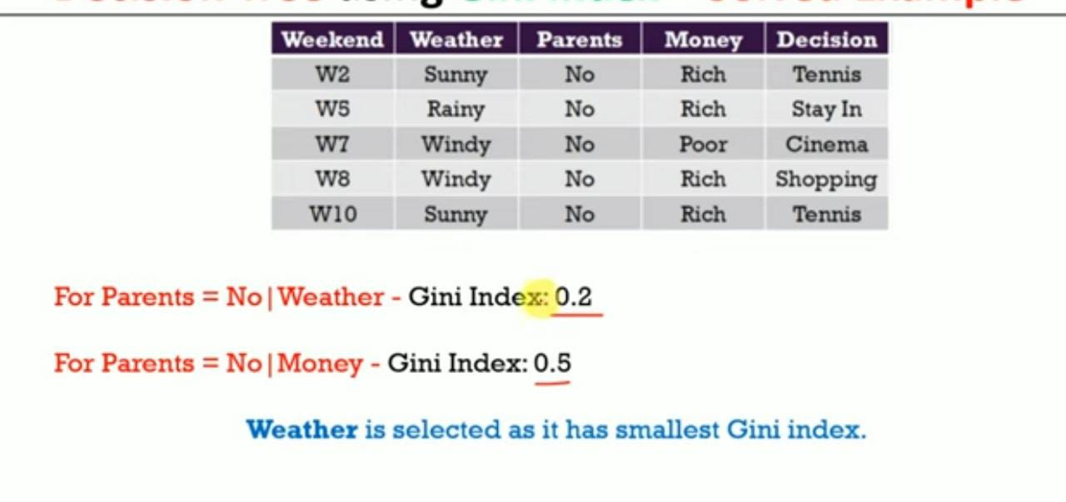

Slide 18
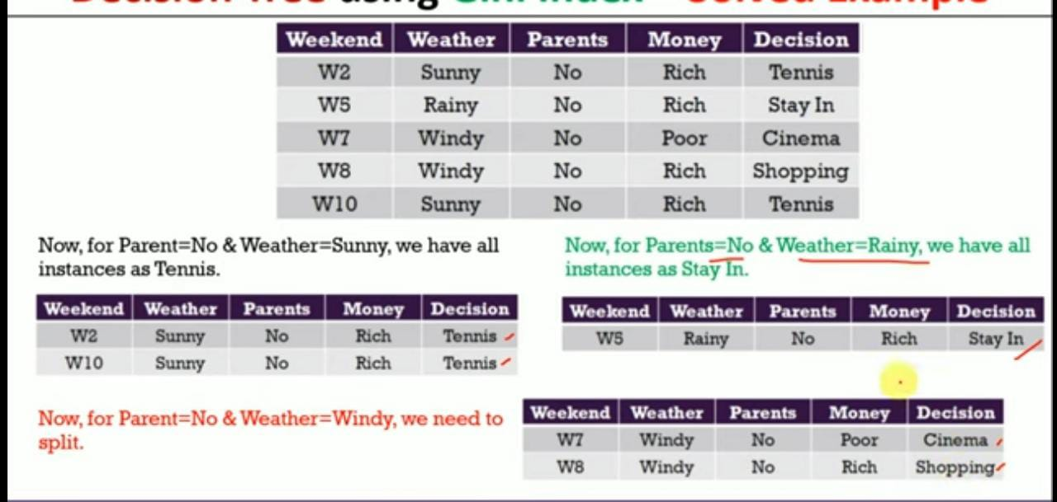

Slide 19
Parents
yes
no
Cinema
Weather
Windy
Rainy
Sunny
Money
Stay in
Tennis
Rich
Poor
Shopping
Cinema

